Slide 1
SQL
Structured Query Language
Presented By:
AKSHAT AMAN
Emp ID: 185847

Slide 2
SQL: Definitions
SQL stands for Structured Query Language.
SQL is Structured Query Language, which is a computer language for storing, manipulating and retrieving data stored in relational database.
SQL is the standard language for Relation Database System. All relational database management systems like “MySQL, MS Access, Oracle, Sybase, Informix, postgres and SQL Server” use SQL as standard database language.

Slide 3

What is the need of sql in java ?

Slide 4
Answer:
With SQL, a user can access data from a relational database management system.
It allows the user to define the data in the database and manipulate it when needed.
It allows the user to create and drop database and table.

Slide 5
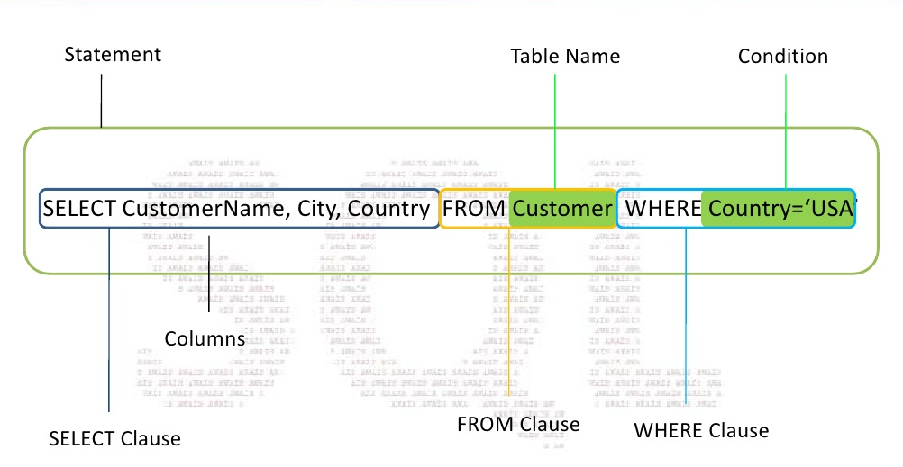
SQL syntax:

Slide 6

Sql commands:
DDL - Data Definition Language
DML - Data Manipulation Language
DCL - Data Control Language
TCL - Transactional Control Language

Slide 7
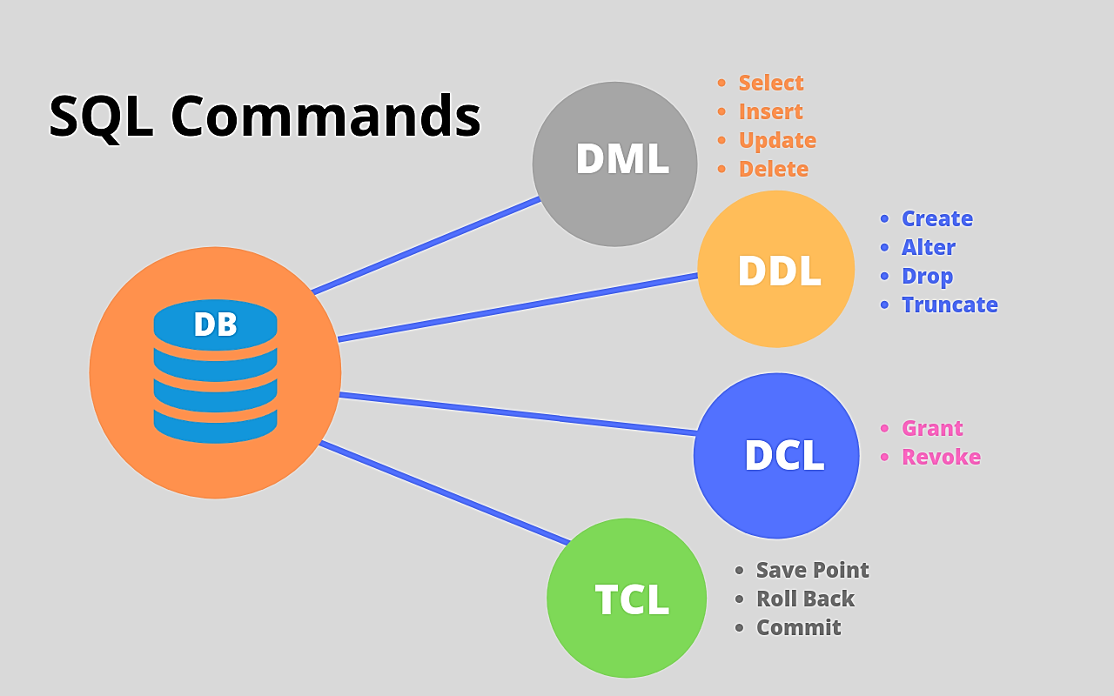

Slide 8
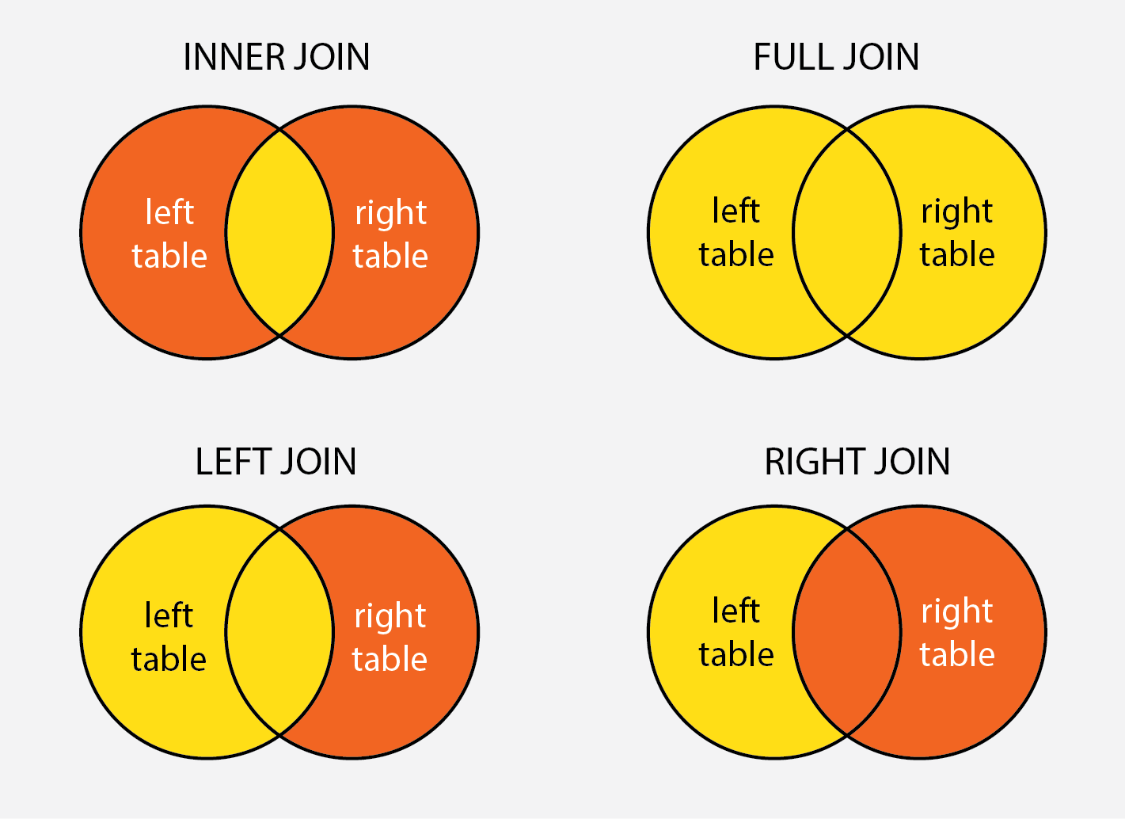
SQL joins:
INNER JOIN: Select records that have matching values in both tables.
FULL JOIN: Selects all records that match either left or right table records.
LEFT JOIN: Select records from the first (left-most) table with matching right table records.
RIGHT JOIN: Select records from the second (right-most) table with matching left table records.

Slide 9

Major takeaways of sql:
With SQL, we can query our database in several ways,
using English-like statements.
With SQL, a user can access data from a relational database management system.
It allows the user to define the data in the database and manipulate it when needed.
It allows the user to create and drop database and table.
It allows the user to create a view, stored procedure, function in a database.
It allows the user to set permission on tables, procedures, and views.

Slide 10
Thank you !!

